Slide 1
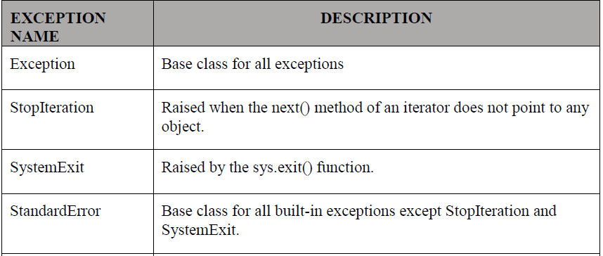
Exceptions :
An exception is an event, which occurs during the execution of a program that disrupts the normal flow of the program's instructions. An exception is a Python object that represents an error.
When a Python script raises an exception, it must either handle the exception immediately otherwise it terminates and quits.
Python provides two types of exceptions : 1. built-in 2. user defined
Built-in Exceptions

Slide 2
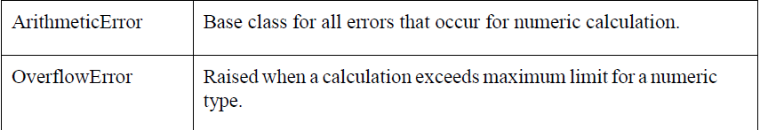
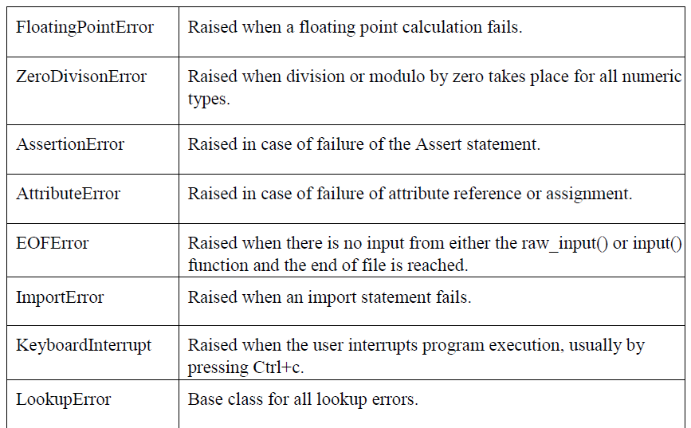

Slide 3
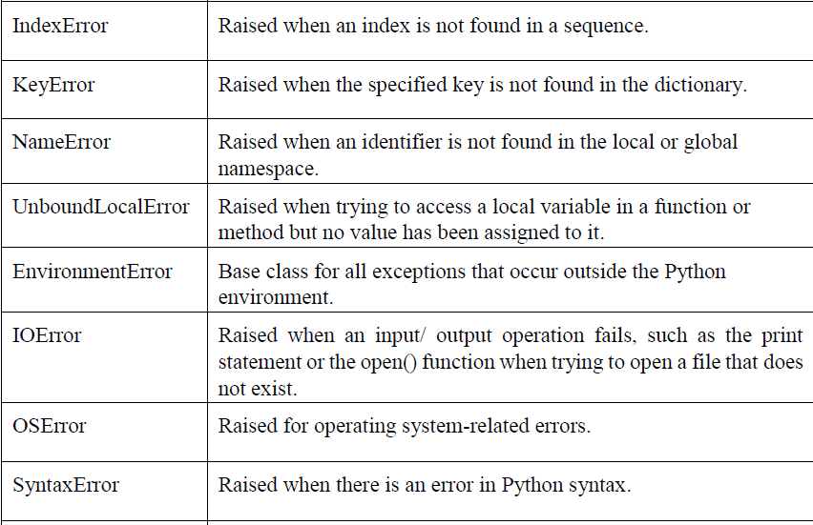

Slide 4
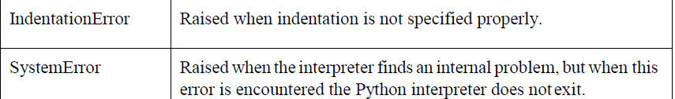
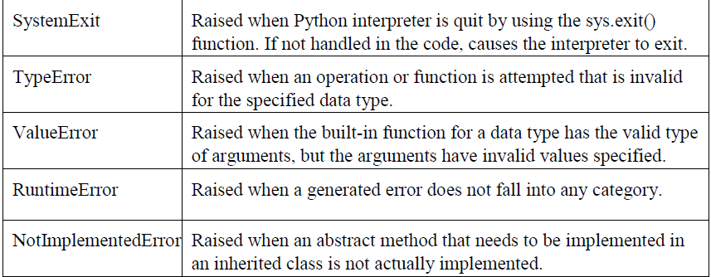

Slide 5
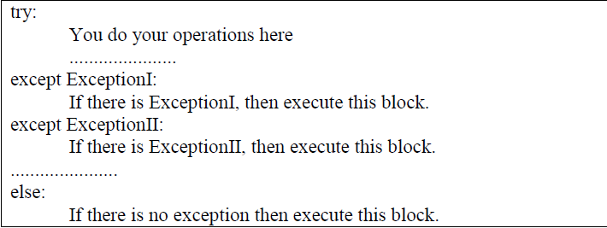
Handling Exceptions :
If you have some suspicious code that may raise an exception, you can defend your program by placing the suspicious code in a try: block. After the try: block, include an except: statement, followed by a block of code which handles the problem as elegantly as possible.
Syntax
Here is simple syntax of
try....except...else blocks-

Slide 6
Introduction to NumPy
NumPy = Numerical Python
Handles large arrays efficiently
Much faster than regular lists
Basis for most analytics libraries
Notes:
Explain NumPy as the 'Excel of Python' but with superpowers for large data.

Slide 7
NumPy Dimensions and Shapes
1D – simple list (marks of 1 student)
2D – table (marks of all students)
3D – multiple tables (data over years)
NumPy makes it easy to manage and reshape this data.
Data Analytics – BE Civil Engineering | Trainer Notes © Your Institute Name
Notes:
Draw an analogy: Excel sheet (2D) vs stacked files (3D).

Slide 8
NumPy arange() and Random Package
arange() – create sequences like range()
random() – generate random data for simulations
Example: Simulate 100 random test scores to analyze class performance.
Notes:
Fun activity: 'Generate random scores and calculate class average in Python.'

Slide 9
NumPy Reshape, Slicing & Masking
reshape() – change data layout
slicing – select subsets of data
masking – filter based on conditions
Example: Filter students who scored above 75%.
Notes:
Compare slicing to 'cutting pieces from a cake' — you’re selecting parts you need.

Slide 10
NumPy Broadcasting
Broadcasting allows arithmetic operations between arrays of different shapes.
Example:
Add 10 to every element in a list of marks instantly.
Notes:
Explain like applying a 10% increase to all prices in a shop — no loops needed.

Slide 11
Activity: Analyze Sample Temperature Data
Using NumPy arrays:
Store daily temperatures
Find average, min, and max
Plot later with Matplotlib (next unit)
Notes:
Encourage group participation: each group makes up a week of 'temperature data' and calculates averages.

Slide 12
Summary & Reflection
We learned:
Python basics for analytics
How to handle and process numerical data using NumPy
Importance of arrays and broadcasting
Reflection: What kind of real-life data would you like to analyze with Python?
Notes:
Close with examples like analyzing attendance, monthly phone usage, or daily steps.

Slide 13
Unit 3: Advanced Data Handling and Visualization in Python
Learning Outcomes:
• Handle and manipulate data with Pandas
• Create different types of charts using Python
• Explore interactive and geo-visualizations
Data Analytics – BE Civil Engineering | Trainer Notes © Your Institute Name
Notes:
Start by showing a chart of something simple like 'class attendance trend' and ask how it helps us understand the data.

Slide 14
Why Data Handling Matters
• Raw data is messy and unstructured
• We need tools to clean, organize, and visualize it
• Better data → better decisions
Data Analytics – BE Civil Engineering | Trainer Notes © Your Institute Name
Notes:
Example: A company analyzing monthly sales to decide which product to promote.

Slide 15
Introduction to Pandas
Pandas = Powerful Python library for data handling.
It helps you:
• Load and save data (CSV, Excel, etc.)
• Clean and process information easily
Data Analytics – BE Civil Engineering | Trainer Notes © Your Institute Name
Notes:
Relate to Excel — Pandas is like Excel on steroids!

Slide 16
Pandas Series – One-Dimensional Data
A Series is like a single column in a spreadsheet.
Example:
marks = [85, 90, 78, 92]
Pandas lets you calculate mean, median, etc.
Data Analytics – BE Civil Engineering | Trainer Notes © Your Institute Name
Notes:
Demonstrate by showing a column of student marks.

Slide 17
Pandas DataFrame – Two-Dimensional Data
A DataFrame is like a complete table with rows and columns.
Example:
• Student names and their marks in different subjects
• Sales data across months
Data Analytics – BE Civil Engineering | Trainer Notes © Your Institute Name
Notes:
Encourage students to imagine a table with subjects vs marks — that’s a DataFrame.

Slide 18
Importing and Cleaning Data
• Read data from CSV files using pd.read_csv()
• Handle missing values with fillna() or dropna()
• Rename, sort, and reset indexes easily
Data Analytics – BE Civil Engineering | Trainer Notes © Your Institute Name
Notes:
Example: Import a 'student_marks.csv' file and clean missing entries.

Slide 19
Data Manipulation using Pandas
Common operations:
• Sorting data
• Filtering rows (e.g., marks > 75)
• Grouping by category (e.g., department)
• Aggregating (mean, count, sum)
Data Analytics – BE Civil Engineering | Trainer Notes © Your Institute Name
Notes:
Run a simple demo: group students by branch and find average marks.

Slide 20
Real-Life Example: Student Performance Analysis
• Read a CSV of marks
• Calculate total and average per student
• Find top 3 performers
• Visualize the results later with Matplotlib
Data Analytics – BE Civil Engineering | Trainer Notes © Your Institute Name
Notes:
Show a small dataset — let students guess who might top the list before analyzing.

Slide 21
Why Visualization Matters
Visualization helps to:
• See trends and patterns
• Communicate insights quickly
• Make data memorable
Data Analytics – BE Civil Engineering | Trainer Notes © Your Institute Name
Notes:
Ask: 'Would you rather see a 10-page report or one clear chart?'

Slide 22
Data Visualization with Matplotlib
Matplotlib is the base library for charts.
• Line charts – trends (e.g., temperature over days)
• Bar charts – comparisons (e.g., marks per subject)
• Pie charts – proportions (e.g., budget split)
Data Analytics – BE Civil Engineering | Trainer Notes © Your Institute Name
Notes:
Demonstrate: plot a simple line chart of daily study hours vs marks.

Slide 23
Data Visualization with Seaborn
Seaborn builds on Matplotlib with better visuals.
Examples:
• Heatmaps – show correlations
• Boxplots – show variation
• Histograms – show distribution
Data Analytics – BE Civil Engineering | Trainer Notes © Your Institute Name
Notes:
Try showing a 'marks distribution' chart to explain why most students score around average.

Slide 24
Interactive Plotting with Bokeh
Bokeh helps create interactive dashboards.
You can zoom, hover, and click for details.
Great for websites and reports.
Data Analytics – BE Civil Engineering | Trainer Notes © Your Institute Name
Notes:
Example: Interactive graph of monthly electricity consumption.

Slide 25
3D Plotting with Plotly
Plotly allows:
• 3D surface plots
• Animated visualizations
• Interactive dashboards
Example: Plot population growth vs income vs education.
Data Analytics – BE Civil Engineering | Trainer Notes © Your Institute Name
Notes:
Mention how professionals use 3D visualization for complex data exploration.

Slide 26
Geo Plotting with Folium
Folium = map-based visualization tool.
Example:
• Map city-wise COVID cases
• Show store locations on a city map
• Display pollution levels geographically
Data Analytics – BE Civil Engineering | Trainer Notes © Your Institute Name
Notes:
Ask: 'Which cities have the highest traffic congestion? Let’s map it!'

Slide 27
Pandas Built-in Plotting
Pandas has a quick .plot() function.
Example:
data['sales'].plot(kind='bar')
Creates instant charts from DataFrames.
Data Analytics – BE Civil Engineering | Trainer Notes © Your Institute Name
Notes:
Demonstrate quick bar chart for monthly sales data.

Slide 28
Hands-on Activity
Task:
1. Create a dataset of 7 days of sleep hours and study hours.
2. Use Pandas to analyze averages.
3. Plot a line chart using Matplotlib.
4. Discuss trends in class.
Data Analytics – BE Civil Engineering | Trainer Notes © Your Institute Name
Notes:
Encourage them to work in small groups and share one observation each.

Slide 29
Summary & Reflection
We learned:
• Pandas for data handling
• Matplotlib, Seaborn, and others for visualization
• How visuals help make sense of numbers
Reflection: What’s one dataset from your daily life you’d love to visualize?
Data Analytics – BE Civil Engineering | Trainer Notes © Your Institute Name
Notes:
Wrap up with a quick poll: 'Which library did you find most interesting today?'

